Slide 1
Endless loop in nested subroutine calls
eg., lr=0x24, overwites the previous value of 0x10
main |  | func1 |  | func2
. . . BL func1 . . . |  | . . . BL func2 . . . MOV pc, lr |  | . . . MOV pc, lr
eg., lr=0x10
cannot return back to main – endless loop
return to func1 at address 0x24

Slide 2
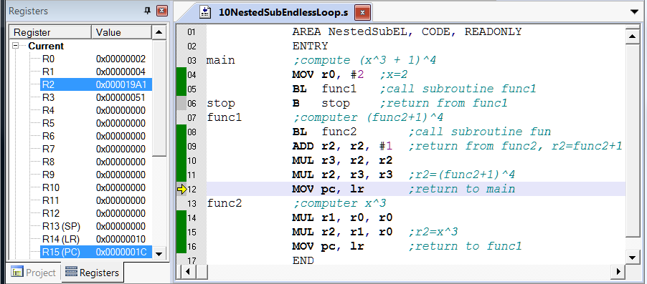
Endless Loop in Nested Subroutine Calls
endless loop
cannot return back to main

Slide 3
PUSH the link register lr in nested subroutine calls
PUSH
main |  | func1 |  | func2
. . . BL func1 . . . |  | STMFD sp!, {lr} . . . BL func2 . . . LDMFD sp!, {pc} |  | . . . MOV pc, lr
POP
return to main
return to func1

Slide 4
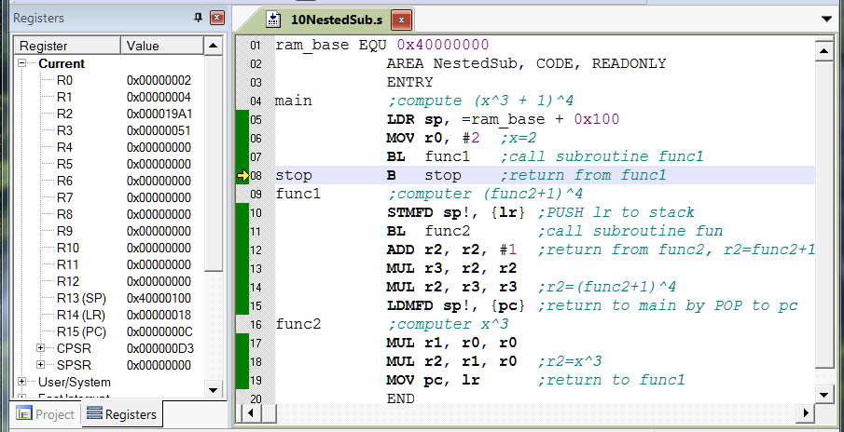
Demo – SOLVED!
PUSH lr to stack at the beginning
POP from stack to pc at the end
1
2

Slide 5
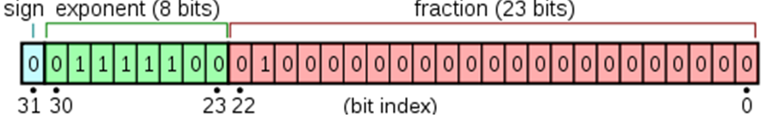
The IEEE 754 standard specifies a binary32 as having:
Sign bit: 1 bit
Exponent width: 8 bits
Significand precision: 24 bits (23 explicitly stored)
Sign bit determines the sign of the number, which is the sign of the significand as well.
Exponent is either an 8 bit signed integer from −128 to 127 (2's Complement) or an 8 bit unsigned integer from 0 to 255.
The true significand includes 23 fraction bits to the right of the binary point and an implicit leading bit (to the left of the binary point) with value 1 unless the exponent is stored with all zeros. Thus only 23 fraction bits of the significand appear in the memory format but the total precision is 24 bits (equivalent to log₁₀(2²⁴) ≈ 7.225 decimal digits). The bits are laid out as follows:

Slide 6
Differences between inline and embedded assembly code
Inline assembly code uses a high-level of processor abstraction, and is integrated with the C code during code generation. Therefore, the compiler optimizes the C code, and the assembly code together.
An embedded assembly code is assembled separately from the C code to produce a compiled object that is then combined with the object from the compilation of the C source.
Inline assembly code can be inlined by the compiler, but embedded assembly code cannot be inlined, either implicitly or explicitly.
Feature | Embedded assembler | Inline assembler
Instruction set | ARM and Thumb. | ARM only.
ARM assembler directives | All supported. | None supported.
Optimization of assembly code | No optimization. | Full optimization.
Inlining | Never. | Possible.
Return instructions | You must add them in your code. | Generated automatically. (The BX , BXJ, and BLX instructions are not supported.)

Slide 7
MOV instruction with immediate operand
MOV r0, #0xFF, 8
3 1 | 3 0 | 2 9 | 2 8 | 2 7 | 2 6 | 2 5 | 2 4 | 2 3 | 2 2 | 2 1 | 2 0 | 1 9 | 1 8 | 1 7 | 1 6 | 1 5 | 1 4 | 1 3 | 1 2 | 1 1 | 1 0 | 9 | 8 | 7 | 6 | 5 | 4 | 3 | 2 | 1 | 0 | Instruction Type
Condition |  |  |  | 0 | 0 | 0 | 1 1 0 1 OPCODE |  |  |  | S | 0 0 0 0 Rn |  |  |  | Rd |  |  |  | Shifter_operand |  |  |  |  |  |  |  |  |  |  |  | MOV
3 1 | 3 0 | 2 9 | 2 8 | 2 7 | 2 6 | 2 5 | 2 4 | 2 3 | 2 2 | 2 1 | 2 0 | 1 9 | 1 8 | 1 7 | 1 6 | 1 5 | 1 4 | 1 3 | 1 2 | 1 1 | 1 0 | 9 | 8 | 7 | 6 | 5 | 4 | 3 | 2 | 1 | 0 | Instruction Type
1 1 1 0 Condition |  |  |  | 0 | 0 | 1 | 1 1 0 1 OPCODE |  |  |  | 0 S | 0 0 0 0 SBZ |  |  |  | 0 0 0 0 Rd =r0 |  |  |  | 0 1 0 0 Rotate_imm |  |  |  | 1 1 1 1 1 1 1 1 8_bit_immediate |  |  |  |  |  |  |  | MOV r0, #0xFF,8

Slide 8
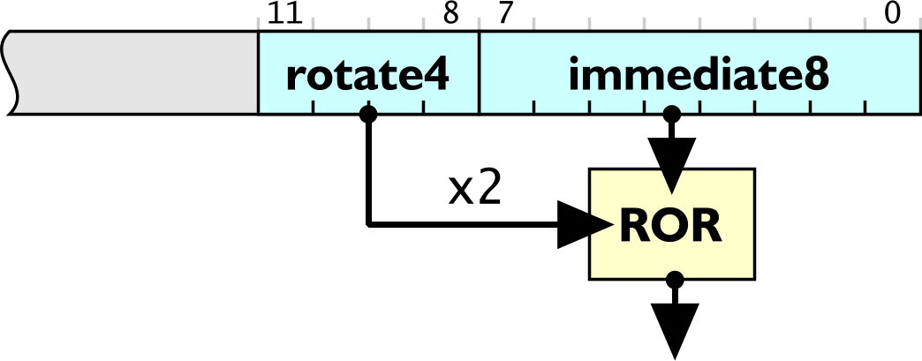
Rotate Right Shifter

Slide 9
Passing Parameters through Registers
Calling program
Sets some registers to contain inputs
Calls subroutine
6) Read from those registers containing outputs
Subroutine
3) Extract contents from registers that contains inputs
4) Performs the action of the subroutine
5) Places the outputs in some registers and return

Slide 10
Passing Parameters through the Stack
Calling program
Pushes inputs onto the Stack
Calls subroutine
6) Stack contain outputs (pop)
7) Balance stack
Subroutine
3) Extract inputs from the stack (pops)
4) Performs the action of the subroutine
5) Pushes outputs on the stack and return

Slide 11

SUBROUTINES
MAIN PROGRAM
AREA, CODE, READONLY
ENTRY
MOV r0, #10
MOV r5, r4
-----
-----
------
------
PROCEDURE
factStack
Instructions for the procedure
•
•
•
BX lr
BL factStack
MOV r4, r6
----------
END

Slide 12
STACK SEGMENT
00
04
08
12
16
SP

Slide 13
STACK SEGMENT
00
04
08
12
SP
16

Slide 14
STACK SEGMENT
00
04
08
SP
12
16

Slide 15
STACK SEGMENT
00
04
SP
08
12
16

Slide 16
STACK SEGMENT
00
SP
04
08
12
16

Slide 17
STACK SEGMENT
00
04
SP
08
12
16

Slide 18
STACK SEGMENT
00
04
08
SP
12
16

Slide 19
STACK SEGMENT
00
04
08
12
SP
16

Slide 20
STACK SEGMENT
00
04
08
12
16
SP

Slide 21
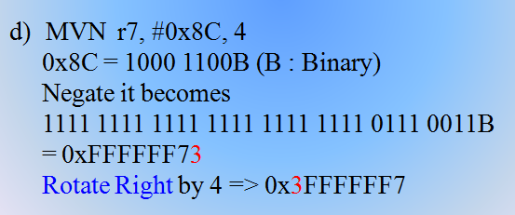
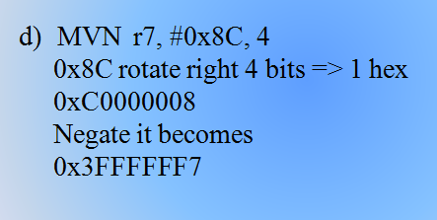
OR

Slide 22
It should be rotation first then negation. The barrel shifter is BEFORE the ALU. Hence the rotation should be done first, followed by the Negation by the ALU.

